Slide 1
HarvestGuard: Leaf Disease Classification
Presented By:
Lauren Taylor, Prachi Khanna, Ryan Laxamana

Slide 2
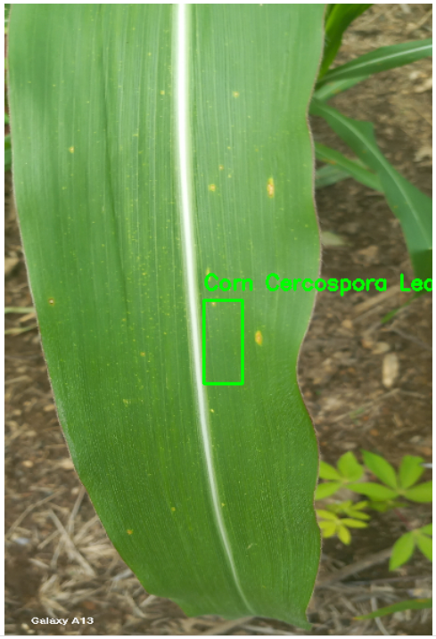
What is HarvestGuard?
Computer Vision Defined: Computer vision aims to replicate human vision capabilities by developing techniques for image formation, which involves simulating the human sensory system, and machine perception, which entails emulating the human cognitive system. This enable machines to interpret and understand visual information, similar to how humans perceive and comprehend the visual world.
HarvestGaurd Defined: Harvest Guard is Multi-class object detection and bounding box regression system which aims to identify classes of diseases on leaves and bounding boxes on it. Afrocentric (African) Crop Dataset is used to design the system.

Slide 3
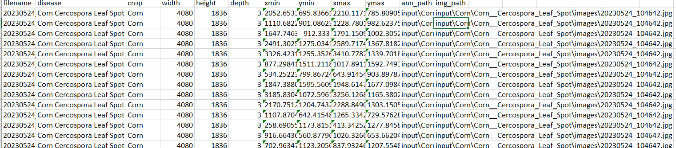
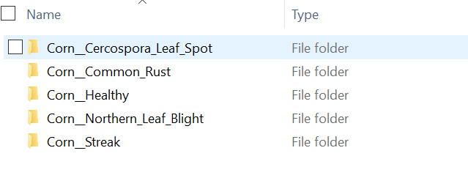
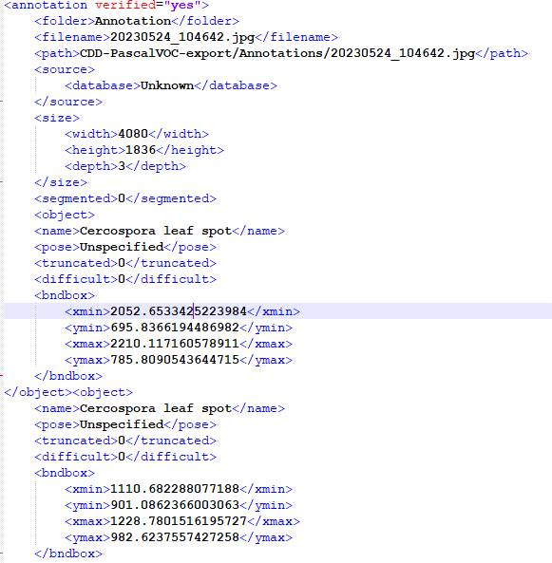
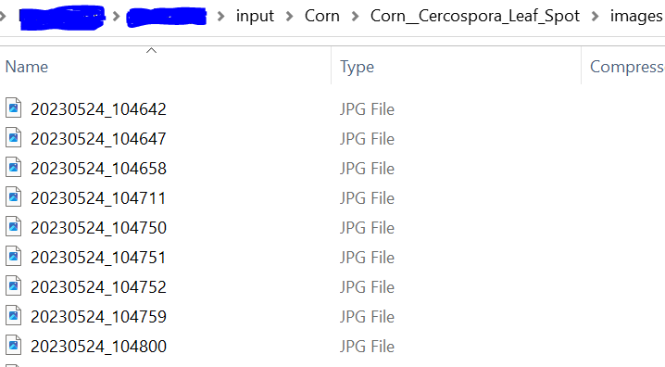
The Dataset
Afrocentric (African) Crop Dataset:
The dataset was created and published by a research group at Kwame Nkrumah University of Science and Technology in Ghana
The dataset represent diverse agricultural scenarios across various African regions. It comprises annotated photos of leaves from a variety of crops, showcasing both healthy specimens and those affected by diseases
The "Afrocentric" dataset is a tailored collection emphasizing the significance of region-specific data for technological solutions.

Slide 4
EDA, Data Augmentation
EDA: Summarized main characteristics of dataset using statistical and graphical visualization. Dataset showcased class imbalance issue among various diseases.
Addressing Class Imbalance: Resampling and data augmentation techniques are used. Resampling ensures that each class is represented adequately, while data augmentation introduces variations to the dataset, promoting a more balanced and diverse representation of each class.
Augmentation Techniques: Augmentation techniques, including flipping, rotation, blur, and noise, are applied to generate a more varied dataset.
Balanced Dataset Creation: The creation of a final balanced dataset aims to ensure equal representation of different classes for model training. This step is pivotal in preventing the model from being biased towards classes with larger representations, fostering fairness in the training process.

Slide 5
Multi-class object detection and bounding box regression
A State-of-the-Art Pretrained Language Model:
VGG16 is object detection and classification algorithm which is able to classify with 92.7% accuracy. It is one of the popular algorithms for image classification and is easy to use with transfer learning.
A Compact and Efficient Iteration of VGG16:
VGG16 network is loaded with weights pre-trained on the ImageNet dataset. We leave off the fully-connected layer head , freeze the body such that weight will not be updates during fine tuning and flatten the output of the network
We created a new layer head responsible for multi-output prediction (i.e., class label and bounding box location).
Fine-Tuned on the Afrocentric (African) Crop Dataset:
By training on images of corp with various diseases and annotations, HarvestGuard becomes an expert in identifying classes of disease on leaves and bounding box on it.

Slide 6
HarvestGuard Overall Architecture
Data Processing
Training Loop
EDA
Training Arguments
Fine Tuned Multi-Class Model
Results Prediction
Afrocentric Crop Dataset
Image Dataset Augmentation
Trainer
Images and bounding boxes resizing
Evaluation

Slide 7
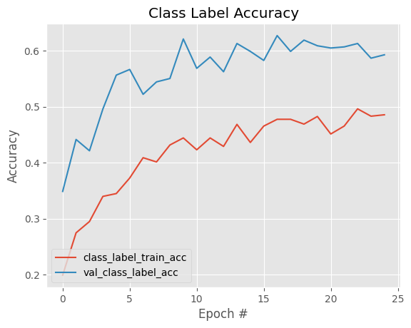
The Results-Classification Model
Metric | Value
Accuracy | 59.2%
Precision (Micro) | 81.2%
Recall (Micro) | 40.9%
F1 Score (Micro) | 54.42%
High Precision, low recall →Low false positive, high false negative
Evidence of model under fitting

Slide 8
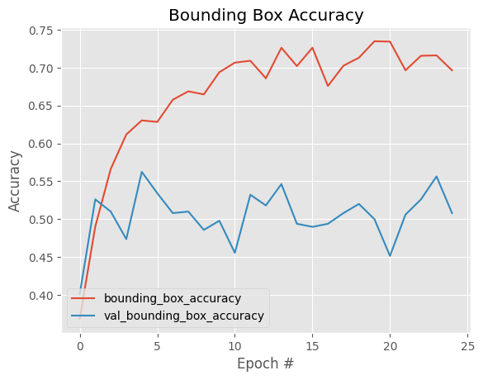
The Results-Bounding Boxes
Metric | Value
Accuracy | 50.8%
Mean Squared Error | 6.37%
Evidence of model overfitting
Instability in validation performance

Slide 9
Findings and Feedback
Precision and Recall Improvement:
Due to limited hardware capacity the model is trained on small sample of images in each disease categories. There's room for enhancing precision by providing more data for model training.
Collect additional samples for underrepresented classes to create a more balanced dataset.
Regional Functionality Enhancement:
HarvestGuard is trained on Afrocentric (African) Crop Dataset samples of which are collected in Ghana. Consider souring crop samples from other regions to improve regional performance

Slide 10
Individual Contributions
Lauren:
Data Preprocessing
Data augmentation
Writing report
Creating slides
Prachi:
Design model
Training model
Model evaluation
Creating slides
Writing report
Ryan:
XX
XX

